Slide 1
Testing Water
Dissolved Oxygen (DO).
Biochemical Oxygen Demand (BOD).
Chemical Oxygen Demand (COD)

Slide 2
Control Measures for Water Pollution
Scientific Technique must be adopted in the Environment
Industry must recycle the water and use.
Plants and Trees are the natural air conditioners.
Forest are the reasons for controlling the SO₂ CO₂
Domestic Sewage must be used for Irrigation.

Slide 3
Control Measures for Water Pollution
Public awareness must be created.
Framing of Laws and must be modified according to the technological development.

Slide 4
Waste Water Treatment
Objectives
To convert harmful component to harmless components.
To eliminate the offensive smell.
To remove the solid content of the sewage.
To destroy disease producing bacteria.

Slide 5
Waste Water Treatment
Primary Treatment
Secondary Treatment
Tertiary Treatment
Disposal
of
Sewage
Treatment process

Slide 6
Waste Water Treatment
Primary Treatment
Settling process.
Large Quantity of organic and inorganic materials removed in this process.
The settling coagulants ( Alum, Ferrous Sulphates ) are added and suspended particles are converted in to settlements.
Al₂(SO₄)₃ + 6H₂O → 2Al(OH)₃ ↓ + 3H₂SO₄

Slide 7
Waste Water Treatment
Secondary Treatment
In this process organic impurities removed by aerobic bacteria.
90 % of Oxygen Demanding Wastes are removed.
To Process
Trickling Filter.
Activated Sludge Process.

Slide 8
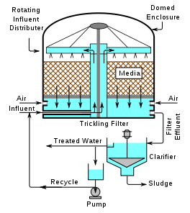
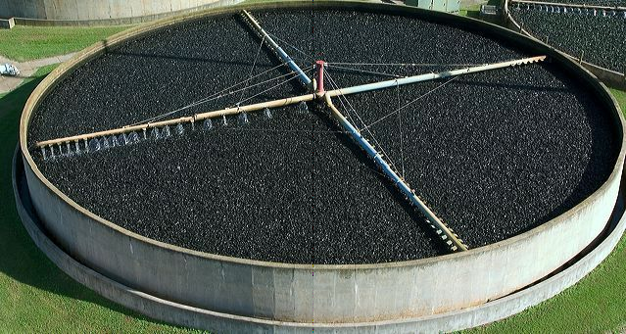
Waste Water Treatment
Trickling Filter Process

Slide 9
Waste Water Treatment
Trickling Filter Process
Tank is filled with coarse or crushed rock.
Sewage is sprayed over the bed by rotating arms.
Sewage is penetrated through bed.
Filtering material ( aerobic bacteria ) use the sewage as food.
After completion of this process 80 to 85 % of BOD is removed

Slide 10
Waste Water Treatment
Activated Sludge Process.
Air Supply
Sewage
Effluent
Aeration Tank
Sedimentation
Tank
From primary
Treatment
Effluent
For drainage
Sludge Settled at the bottom
Activated
Sludge
Excess
Sludge

Slide 11
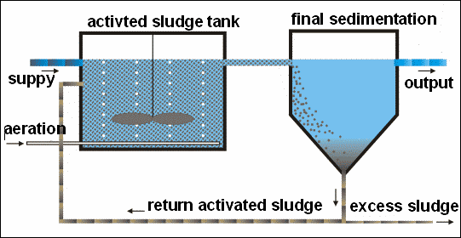
Waste Water Treatment
Activated Sludge Process.

Slide 12
Waste Water Treatment
Tertiary Treatment
After Secondary Process BOD level comes to 25ppm.
Effluent is introduced to flocculation tank.
Lime is added to remove phosphates.
Ammonia is removed in the form of gas.
Finally passed through charcoal to filter minute organic maters.
Finally water is treated with disinfectant(chlorine).

Slide 13
Waste Water Treatment
Disposal of Sewage
Dumping into low lying Areas.
Burning of Sludge.
Dumping into sea.
Use it as lo grade fertilizers.

